Slide 1

SPIL Planning
Town Hall Meeting
November, 2018

Slide 2
Mission Statement
Equal participation of people with disabilities within their communities.
https://www.silcga.org/about/

Slide 3
Talk with us…
Your ideas are important:
  What is the greatest barrier to your independence?
  What do you think is the greatest barrier for our community as a whole?

Slide 4
State Plan for Independent Living
2017-2019

Slide 5
Goal 1: Improve and expand consumer access to transportation
Description: Work with Department of Transportation, local municipalities and CIL’s to generate status and advocacy report(s) and increase mobility options for people with disabilities.

Slide 6
Goal 2: Improve the consumer access to affordable, accessible and inclusive housing.
Description: Work with Department of Housing, housing authorities and other housing agencies/organizations to encourage the development of appropriate housing options for persons with disabilities.

Slide 7
Goal 3: Develop opportunities for consumer employment
Description: Collaborate with GVRA, Department of Labor and other entities to develop meaningful policy to encourage employment opportunities for persons with disabilities.

Slide 8
Goal 4: Elevate access for individuals with disabilities to healthcare services and supports.
Description: Promote ongoing participation in initiatives such as Medicaid Buy-In, home and community services, and managed care services.

Slide 9
Goal 5: Increasing out-reach efforts for education & public awareness to consumers, policy makers and relevant professionals.
Description: Consumer, potential stakeholders and policy makers are more knowledgeable about the CIL’s and the progress made to increase diversity within the community and highlight the needs of specific populations.

Slide 10
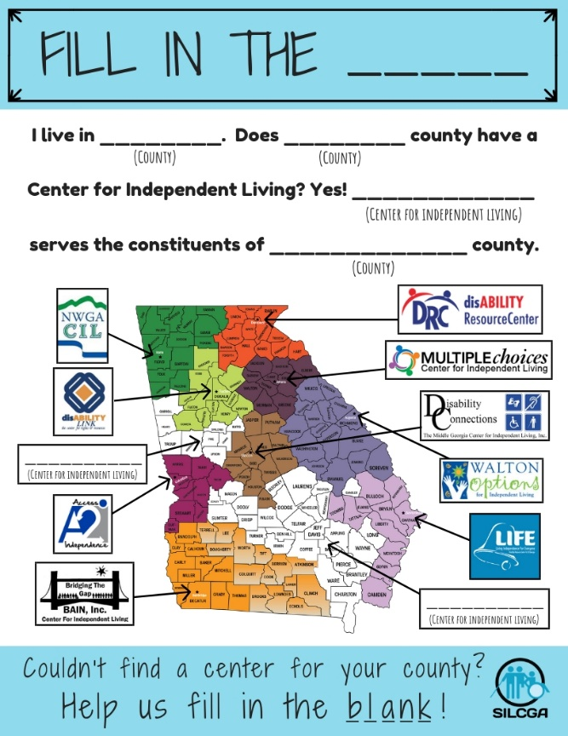
CIL
Expansion

Slide 11
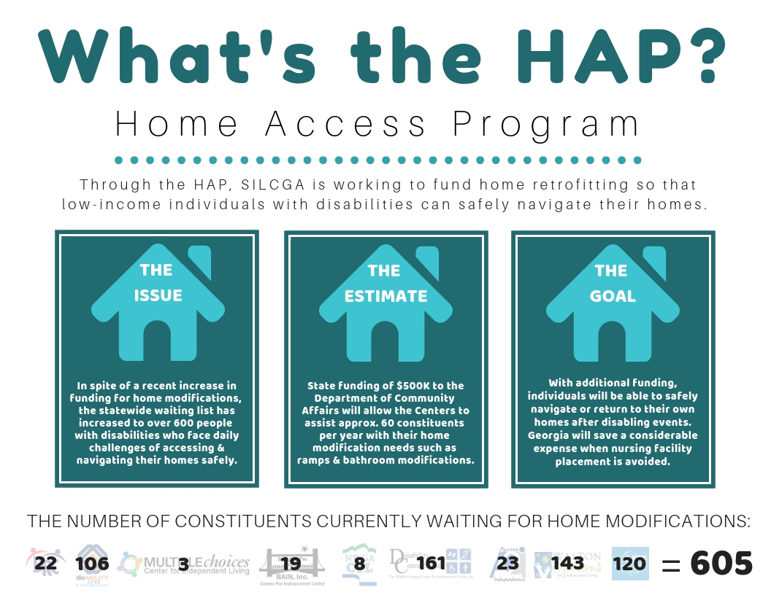

Slide 12
Q & a
What are the top three barriers for Georgians with disabilities?
What do you think is the most critical issue facing Georgians with disabilities today?
What do you think is the greatest barrier to your independence?
What is the greatest barrier to independence as a whole for our community?

Slide 13
CILs
Centers for Independent Living
Non-residential, community-based organizations, governed and staffed by people with disabilities, that offer a wide variety of services to consumers

Slide 14
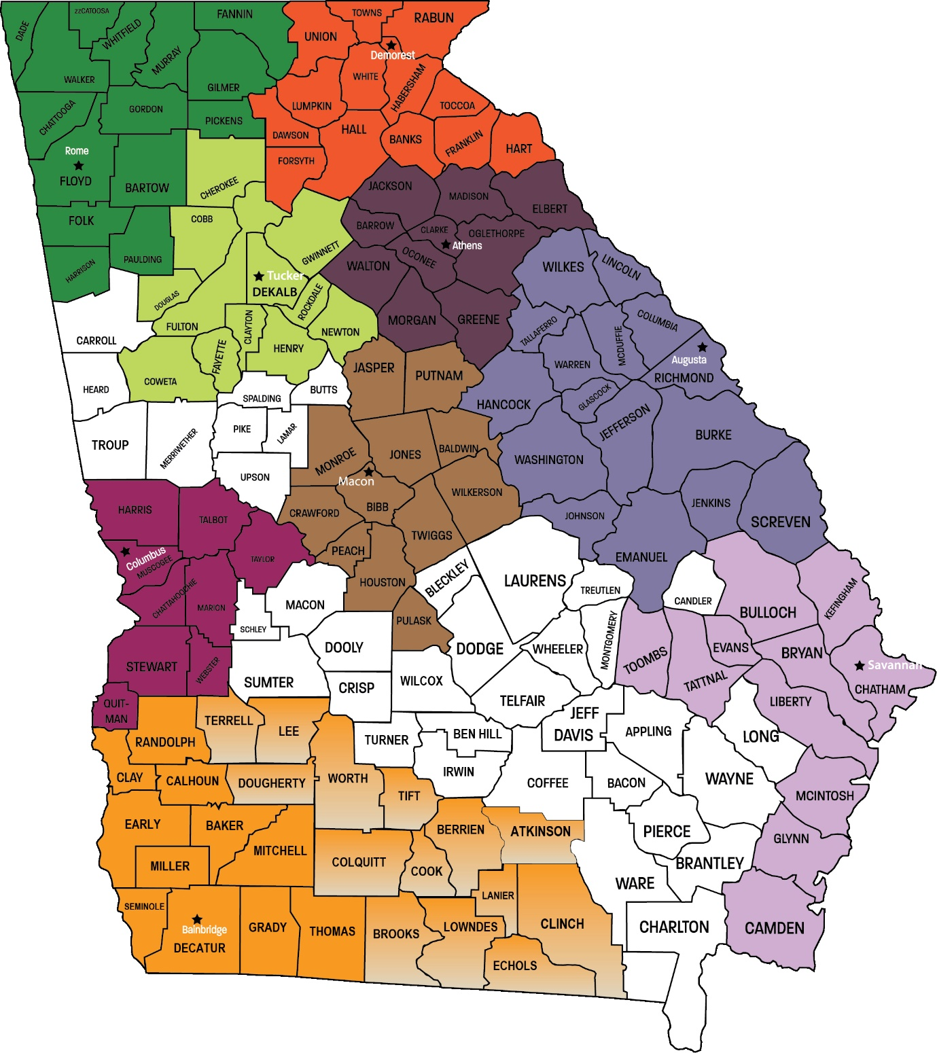
Current CIL Coverage

Slide 15
Consumer Data
(Totals)
Consumers Served 2,464
Consumer Goals Set 3,493
Goals Achieved 1,594
Fiscal year 2017

Slide 16
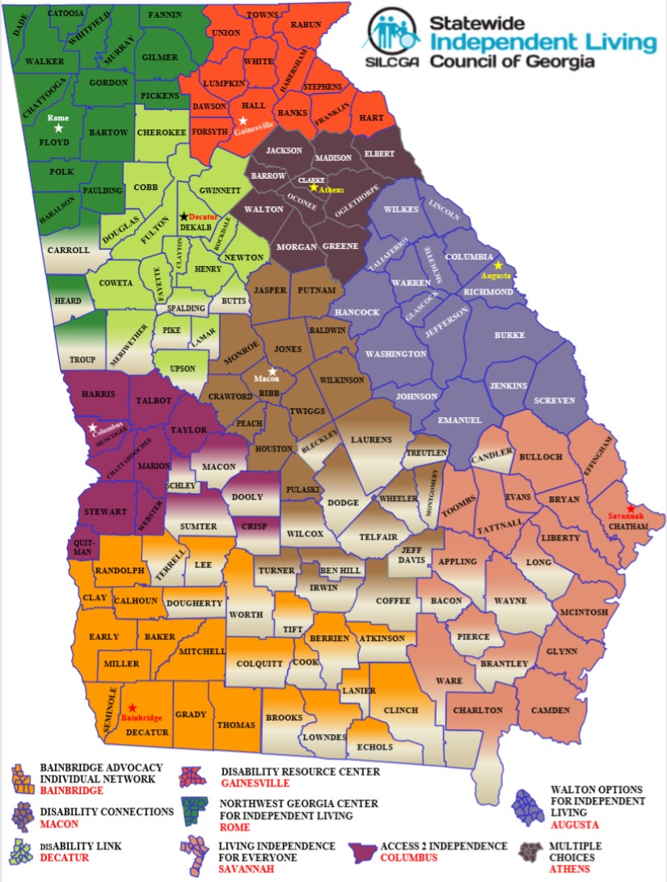
Proposed CIL Coverage

Slide 17
Do You Know Your Legislators?

Slide 18

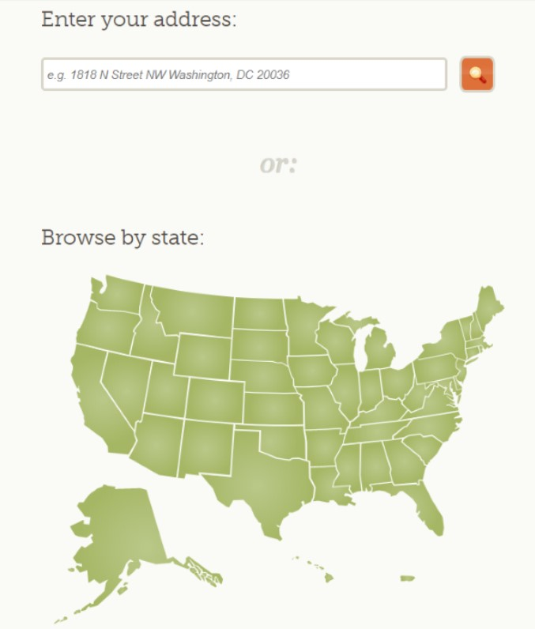
www.openstates.org

