Slide 1
JANUARY 2020 - BOARD MEETING

Slide 2
TODAY’S AGENDA
Call to Order – Phil Chase
Roll Call – Shelly Simmons
Review and Approve Agenda – Phil Chase
Review and Approve Minutes from Fall Meeting – Phil Chase
Legislative Session/Advocacy Days Training – Shelly Simmons
Board Training – Laura Harker, GPBI
Housing Update – Marty Collier
Board Development – Shelly Simmons
Executive Director Report – Shelly Simmons
Brag ‘n Steal
Location of Next Meeting – Becky Ramage-Tuttle
Adjournment – Phil Chase

Slide 3
ROLL CALL – Shelly Simmons

Slide 4
REVIEW & APPROVE – Phil Chase

Slide 5
REVIEW AND APPROVE
Current Agenda
Previous Minutes

Slide 6
LEGISLATIVE SESSION/ADVOCACY DAYS – Shelly Simmons

Slide 7
GCDD’S 2020 ADVOCACY DAYS

Slide 8
DISABILITY LINK’S ADVOCACY DAYS & TRAININGS

Slide 9
COVER GA – Laura Harkin, GBPI, Senior Policy Analyst

Slide 10
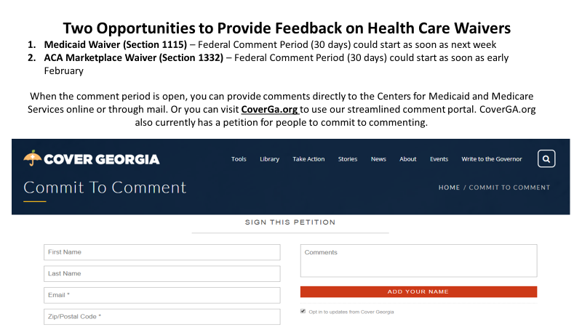

Slide 11
HOUSING UPDATE – Marty Collier

Slide 12
LEGISLATIVE SESSION – Shelly Simmons

Slide 13
BOARD DEVELOPMENT – Shelly Simmons

Slide 14
EXECUTIVE DIRECTOR REPORT – Shelly Simmons

Slide 15
FEBRUARY 20TH, 2020 | 6-9PM THE NATIONAL CENTER FOR CIVIL AND HUMAN RIGHTS

Slide 18
BRAG n STEAL
Board Members
Centers for IL
Guests

Slide 19
NEXT MEETING
Spring Face-to-Face
Date: April 24, 2020
Location: TBD

Slide 20
ADJOURNMENT – Phil Chase

Slide 21
THANK YOU for your continued hard work!

