Slide 1

JANUARY 2021 - BOARD MEETING

Slide 2

TODAY’S AGENDA
I. Call to Order – Shelia Kitchens
II. Roll Call – Shelly Simmons
III. Review and Approval of Agenda – Shelia Kitchens
IV. Review and Approval of Fall Meeting Minutes – Shelia Kitchens
V. Board Training – Kay McGill, Project Independence, Georgia Low Vision Program
VI. Budget & Home Access Program Update – Becky Ramage-Tuttle
VII. Executive Director’s Report – Shelly Simmons
VIII. Division of Aging Services Update – Jennifer Coyne
IX. GVRA Update – Harriett Young
X. SRC Update – Kate Brady
XI. Board Training – Jerri Davison & Sandy Jordan, Hire Me SC
XII. Next Meeting
XIII. Adjournment – Shelia Kitchen

Slide 3
CALL TO ORDER – Shelia Kitchens

Slide 4
ROLL CALL – Shelly Simmons

Slide 5
REVIEW AND APPROVE
Current Agenda
Previous Minutes

Slide 6
PROJECT INDEPENDENCE – Kay McGill

Slide 7
BUDGET REVIEW – Rebecca Ramage-Tuttle

Slide 10
EXECUTIVE DIRECTOR’S REPORT – Shelly Simmons

Slide 11
DIVISION OF AGING SERVICES UPDATE – Jennifer Coyne

Slide 12
GVRA UPDATE – Harriett Young

Slide 13

Agency SWOT Analysis
Strengths
Diversity
Weaknesses
Communication
Threats
Perceptions
Opportunities
Service Delivery
Resources
Continuity
Culture
Training and Development
Resource utilization
Inconsistency/Continuity
Optimism
Impact
Impact/Capacity
Resource Utilization
Continuity/Focus
Diversity
Direction
Openness

Slide 14
SRC UPDATE – Kate Brady

Slide 15
HIRE ME SC – Jerri Davison & Sandy Jordan

Slide 16


Hire Me SC
Jerri Davison, Assistant Director: Able SC
Sandy Jordan, Director of Employment Program: Able SC

Slide 17
What is Hire Me SC?
People with disabilities can work, want to work, and should be afforded every opportunity to work.
Hire Me SC is a statewide campaign that promotes a culture of inclusion across the state of South Carolina, one in which employment for every individual, disability or not, is the norm rather than the exception.
Powered by Able SC and the South Carolina Disability Employment Coalition (“SCDEC:” a coalition formed to eliminate employment barriers for individuals with disabilities).
The Coalition formed in 2014 through funding from the SC Developmental Disabilities Council. Able SC received a five-year systems change grant (Partnerships in Employment) through ACL in 2016 which allowed the Coalition to expand and the creation of Hire Me SC.

Slide 18

SC Employment First Initiative
Youth with disabilities
  Pilot program/data collection
  Peer support groups
  Hire Me SC social media campaign
People with disabilities, service providers, and the community at large
  Disability Benefits and Employment workshops
  Employment First trainings
  SC APSE chapter
  Supported Decision Making
  Legislation
Employers
  Trainings
  Employer Summit
  Business Coalition

Slide 19














Partners
Notes:
13 partners that have signed an MOU with us for the SCEFI. Other two CILs involved.

Slide 20
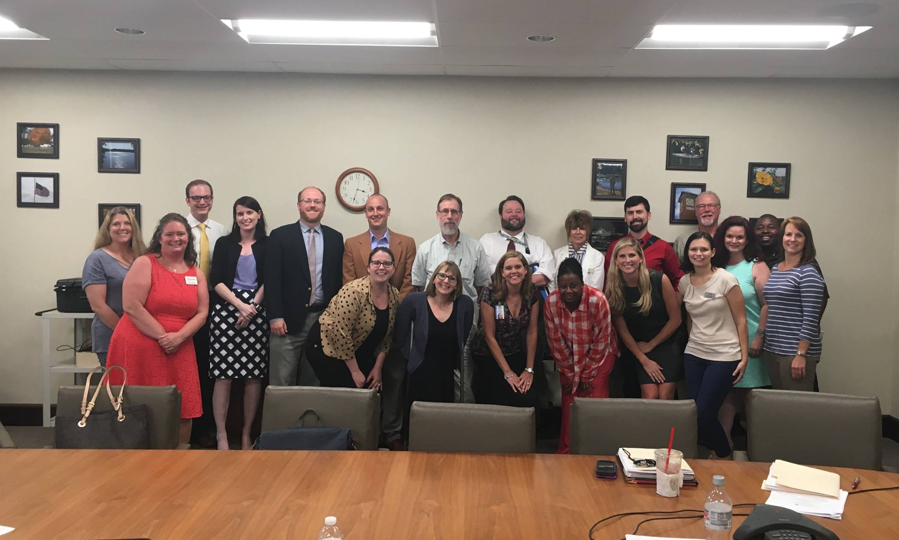
Real Work with Partners
Collaborative approach to working through barriers
  Systems mapping
  Journey mapping
Building partnerships at state and local level
  ACCESS grant, VR involvement
  DDSN/VR collaboration
Giving solutions
  Best practices
  Medicaid waiver (all partners agreed)

Slide 21
Systems Mapping
Purpose: document how a system currently functions. Creates a visual of how a consumer experiences a system.
Phase One: Information Gathering
  Documented process points, factors, barriers, and intersections (used different shapes and colors for each piece).
Phase Two: Analysis
  Once map is complete, different individuals from agency (local and state) reviewed map and gave input, edits, and additions.
Phase Three: Presentation of Maps
  All maps were presented to partners with ongoing discussion on improvement of systems.
Notes:
Helps stakeholders visualize strengths and weaknesses of the system, opportunities to align systems, optimize resources, and improve outcomes.
Phase one: Divided partners in small groups to map out systems. Agency being mapped included agency representatives. Mapped 6 agencies.

Slide 22
Journey Mapping
Journey Mapping takes the process of systems mapping to the individual level. A map is created to detail an individual’s experience within a system.
Like systems mapping, process points, factors, barriers, and intersections are documented.
The professional takes notes, ask questions, and then creates a map based on the consumer’s experience. The map is shared with the consumer and consumer makes edits as needed.
Once map is complete, it is shared with the partners to discuss what changes can be made to make our systems work better.
Notes:
The consumer is shown the systems map for the agency they have experienced barriers with and asked how they experience differed from the map.
Preference is to map a consumer that has had barriers within multiple systems to not single out one system.

Slide 23
In Retrospect
What helped
What could have helped
National technical assistance involvement.
Monthly, recurring meetings with partners. Chair from another agency.
Enhancing programs that already existed instead of creating new programs (ex. CTE).
Champions from each agency.
SC Chamber involvement.
Dept of Transportation involvement.
Better agency collaboration as a foundation.
Minimal leadership turn-over.

Slide 24
High Importance
Systems change work
  To make real, lasting change we had to continuously focus on systems change work.
Data collection
  Pilot program: data allowed us to see what was really happening.
Work with employers
  Employers collaborating with each other through Business Coalition.
Engaging local partners
  Insight into what was happening on the ground level. Focus on what practices within a system that needed to change.
Evidence-based best practices
Sharing the independent living philosophy
  Employment First
  Setting high expectations for people with disabilities

Slide 25
Sustainability
Time-limited workgroups for 3 out of the 4 committees.
Able SC Ticket to Work funding for staff time.
Employer Summit revenue.
Benefits and Employer trainings online.
Partners involvement without additional funding.
Sharing knowledge/best practices
    Pilot program-Community of Practice
    SC APSE-Community of Practice
    Several presentations on SPED/CTE collaboration

Slide 26
Questions?
                Sandy Jordan
                Email: sjordan@able-sc.org
                Hire Me SC
                Website: www.hiremesc.org
                Facebook: https://www.facebook.com/HireMeSC
                Instagram: https://www.instagram.com/hire_me_sc
              Twitter: https://twitter.com/hiremesc

Slide 27
BRAG n STEAL
Board Members
Centers for IL
Guests

Slide 28
NEXT MEETING LOCATION
Spring Teleconference
Date TBD

Slide 29
THANK YOU for your continued hard work!

