Slide 2
Interpreters provided by:

Slide 3
Zoom How Do’s & Don’t’s
DO ask questions using either Q & A or Raise Hand feature
DO describe yourself when speaking including pronouns (i.e. she/her)
DON’T be afraid to speak up!
DO share away on Social Media and get the word out about today’s event, TAG YOUR REPS & SENATORS!!!

Slide 4
Shelly Simmons – Executive Director

Slide 5
SUCCESSES
Celebrated the 30th Anniversary of the ADA
IL Day @ the Capitol
Three-Year State IL Plan (FY21-FY23)
Annual Report

Slide 6
FISCAL YEAR 20
In the aggregate, FY20 was another year of continued services while dealing with a public health crisis and civil unrest, the CILs assisted/helped transition individuals into the community. In fact, the Network helped transition 216 people through the Money Follows the Person (MFP) program. That number was a 142% of the original goal. Nursing Home Transition (NHT)-state funds 191 persons at 111% of the goal. It is also gratifying to know the Network served over 2400 individuals, and facilitated numerous presentations.

Slide 7
LEGISLATIVE AGENDA
Restore Funding to the Network
Modernize the GMWD Buy-In Program
Restore Funding to HAP

Slide 8
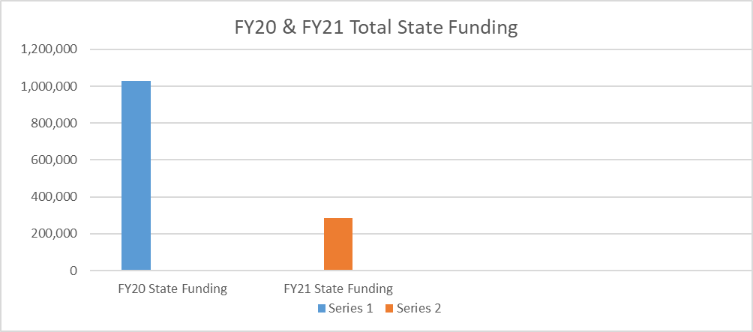
FUNDING CUTS & RESTORATION

Slide 10
CURRENT
CIL COVERAGE

Slide 11
Funding Restoration
Contact local Representative – www.openstates.org
Contact the Appropriations Human Resources Subcommittee
Rep. Katie Dempsey (Chairperson)
Rep. Tom Kirby (Vice Chairman)
Rep. Tommy Benton, Rep. Emory Dunahoo, Rep. Don Hogan, Rep. Wayne Howard, Rep. Karen Mathiak, Rep. Greg Morris, Rep. Mary Margaret Oliver and Rep. Bert Reeves (Members)

Slide 12
Funding Restoration
Contact local Senator – www.openstates.org
Contact the Senate Appropriations Human Development & Public Health Subcommittee
Sen. Ben Watson (Chairman)
Sen. Dean Burke (Vice Chairman)
Sen. Emanuel Jones, Sen. Butch Miller, Sen. Kay Kirkpatrick, Sen. Nan Orrock, and Sen. Lindsey Tippins (Members)

Slide 14
HOME ACCESS PROGRAM
$100,000 for the present fiscal year
5 modifications completed and 1 under construction
Projects have included – grab bars, bathroom modifications, widening of doorways, ramps, etc.
Projects require STRONG consumer participation

Slide 16
HAP Funding Contact:
Appropriations - Economic Development Subcommittee – House
Name | District | Position
Penny Houston | 170th | Chairman of Subcommittee
John LaHood | 175th | Vice-Chairman of Subcommittee
Josh Bonner | 72nd | Member
Robert Dickey | 140th | Member
Carl Gilliard | 162nd | Member
Joseph Gullett | 19th | Member
Mack Jackson | 128th | Member
Danny Mathis | 144th | Member
Jan Tankersley | 160th | Member
Steve Tarvin | 2nd | Member
Name |  | District | Position
Bruce Thompson |  | 14th | Chairman
Matt Brass |  | 28th | Vice Chairman
Emanuel Jones |  | 10th | Secretary
Lee Anderson |  | 24th | Ex-Officio
Tonya Anderson |  | 43rd | Member
Brandon Beach |  | 21st | Member
Frank Ginn |  | 47th | Member
Donzella James |  | 35th | Member
Harold Jones II |  | 22nd | Member
Jeff Mullis |  | 53rd | Member
Sheikh Rahman |  | 5th | Member
Carden Summers |  | 13th | Member
Horacena Tate |  | 38th | Member
Appropriations - Economic Development Subcommittee – Senate

Slide 17
House Bill 99
“Restroom Access Act”
Allows persons with eligible medical conditions to use restrooms at retail establishments
Eligible medical conditions include Crohn’s Disease, ulcerative colitis, any other inflammatory bowel disease, irritable bowel syndrome, or any other medical condition that requires the immediate access to a toilet facility

Slide 18
Support of Legislation
HB 204
Provide state civil rights law protecting individuals from discrimination in housing, public accommodations, and employment.

Slide 19
Maggie Frederick - Housing Policy Coordinator

Slide 20
AFFORDABLE HOUSING LEGISLATION
HB 346 - Healthy Housing
Prohibits retaliatory eviction of tenants complaining to code enforcement of unsafe and unhealthy rental housing conditions.
Status: Passed the House; Senate Judiciary Committee.

Slide 21
Housing Day at the Capitol 2021 – Georgia Advancing Communities Together, Inc. (georgiaact.org)
OUR HOMES, OUR CHILDREN:
2021 Virtual Housing Day at the Capitol
Hosted by Georgia Advancing Communities Together, Inc., Enterprise Community Partners, Georgia STAND-Up, the Empire Board of Realtists, and the Georgia Supportive Housing Association
Wednesday, February 24, 2021 from 10:00 AM to 12:00 PM (EST)
Registration link:
Meeting Registration - Zoom

Slide 22
Jordan Hall – Mobility Policy Coordinator

Slide 23
ITS4US Complete Trip Project
The purpose of the project is to give riders with mobility needs furthers assistance within their travel. This includes helping navigate trips across county lines using coordination software. Other project features include:
A mobile app, available in multiple languages, that helps all travelers safely cross intersections, request transit connections, and identify safe boarding/alighting locations
Wayfinding and navigation that incorporates all walking paths, providing more reliable connections
Tools that provide safe and efficient walking itineraries with building entry locations and landmarks, enhancing the travel experience for vulnerable road users
Routes that utilize sidewalk condition information and are tailored to the user’s specific needs
A prioritization system that gives buses running behind schedule higher priority when a vulnerable road user is on the bus or waiting at a stop

Slide 24
The University of Georgia Institute on Human Development and Disability –
In an effort to increase awareness of the need for transit the Statewide Independent Living Council‘s Mobility Coordinator has had the honor of participating in videos highlighting the need for transportation. The video below is from The University of Georgia Institute on Human Development and Disability. It is meant to highlight the needs for transportation in regard to employment and economic growth. We encourage that this video and videos like it be shared with the Georgia Legislators. Representative Rick Jasperse and Senator Frank Ginn are the new Chairmen of the Transportation Committees. https://www.fcs.uga.edu/ihdd/transportation-project

Slide 25
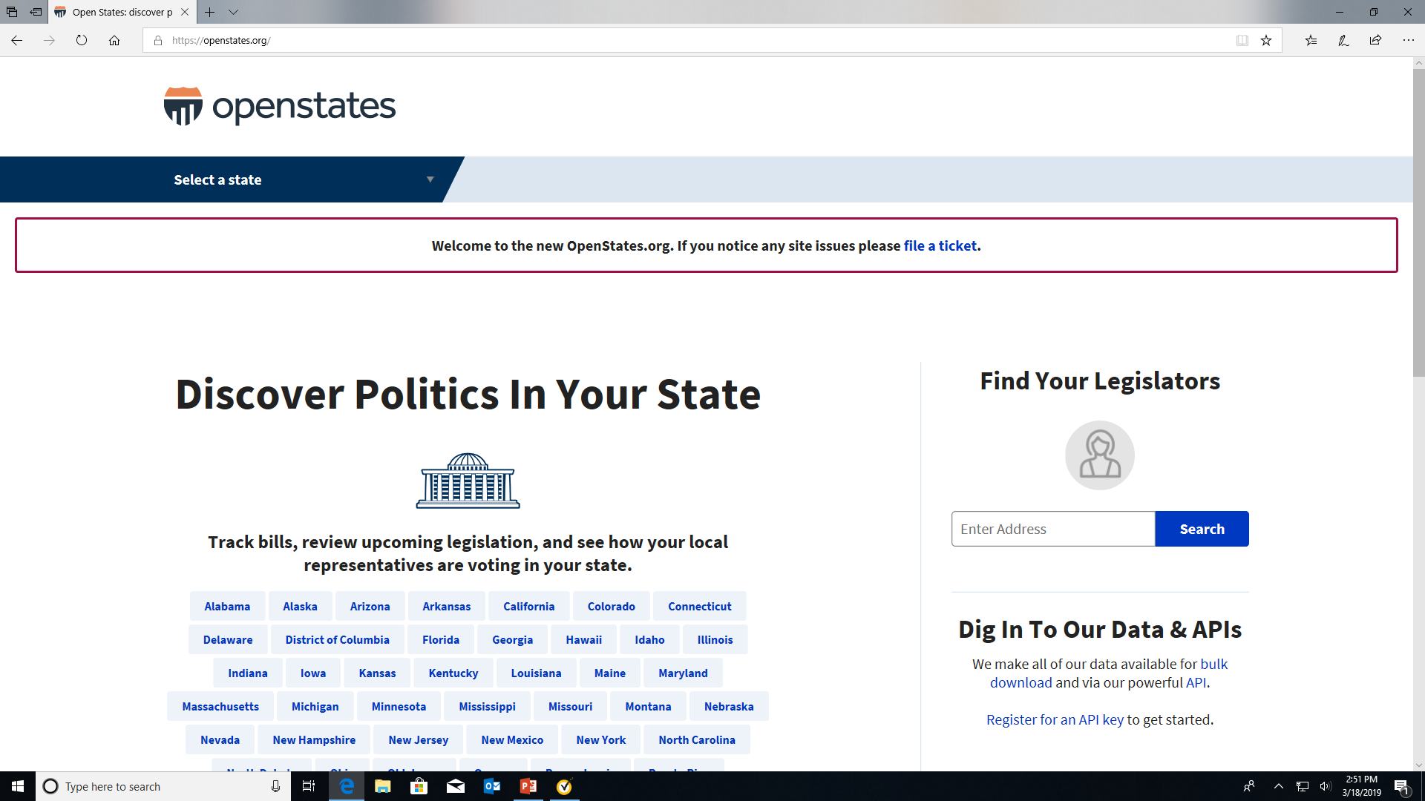

Slide 26
HB 531
HB 531 would eliminate Sunday voting, which in 2020 was used by 71,764 of Georgia voters - 36.7% of whom are Black voters. Black voters made up 36.4% of the voters on the days that Barry Fleming wants to eliminate.
In the 2020 general election, of the over 2.5 million Georgians who voted early in person, 9.9%, or over 250,000, voted on a weekend - these voters would face new restrictions under HB 531. 13% of AAPI voters who voted early and 11.8% of Black voters who voted early cast their ballots during weekend voting.
66,159 voted on the Saturday that would be eliminated by HB 531’s reduction of weekend voting, and 136,218 voted on Columbus Day, which would also be eliminated under HB 531.
In the 2020 general election, in 107 out of 159 Georgia counties, Black Georgians were more likely than white Georgians to vote on weekends instead of during the week - 11.8% of Black voters compared to only 8.6% of white voters. HB 531’s proposed elimination of Sunday voting and restriction of weekend voting would disproportionately and discriminatorily harm Black voters.

Slide 27
HB 531
HB 531 would ban and criminalize offering food or water to voters. In 2020, voters faced hours-long wait times - some so long in summer temperatures and November voting lines that voters fainted, collapsed, and required medical attention. Line warming helps voters stay comfortable while waiting to vote, and banning it harms Georgia voters.
Under HB 531, only provisional ballots cast in the correct precinct will be counted. This will significantly increase ballot rejections, and is a departure from existing practice - potentially costing many voters their right to vote.
HB 531 adds new photo ID requirements to vote by mail - requiring a copy of photo ID on the application if a voter has no driver’s license. This not only impacts voters who do not have a photo ID (disproportionately Black and brown voters) or access to a copier or printer to submit their ID, it also puts voters at increased risk of identity theft.
After the 2020 election cycle saw historically high use of mail voting, HB 531 proposes dramatically reduced timeframes for applying and mailing of mail ballots. It reduces the period to apply for an absentee ballot from 180 days by over half, to a maximum of only 78 days, and sets a minimum application deadline of 11 days before Election Day.

Slide 28
HB 531
Talking Points for Volunteers calling state legislators:
HB 531 would severely restrict voting rights in Georgia and hurt Georgia voters. These restrictions are dangerous, unnecessary, and disenfranchising.
The rushed process of filing and hearing HB 531 cut Georgians out, and it’s outrageous to push a bill like this so quickly without a chance for the public to know, see, or comment on it.
This bill has been rushed through without scrutiny or review, and without time for legislators to properly read it or consider its implications.
Any consideration of this bill must slow the process - HB 531 would dramatically change many parts of our elections and voting process, and must be reviewed carefully to understand the legal ramifications of these changes.
HB 531 is seeking to fix nonexistent problems, and in many cases creates entirely new problems itself. The 2020 election saw historic participation; trying to restrict voting and access to voting now is patently transparent and unacceptable.

Slide 29
HB 531
Any bill to significantly change elections in our state, like HB 531, must involve careful and bipartisan discussion and cooperation, which this bill does not. Democratic legislators were shut out of the process, and even many Republicans were blindsided by this bill, which was drafted without consultation or consideration from wider membership.
Bills to change our voting laws should be made by consulting with voting rights advocates to ensure that new changes to not harm voters - something that was not done with HB 531. As a result, this surprise bill is harmful to Georgians.
Talking Points for Volunteers Calling County Elected Officials:
HB 531 contains provisions that would pass on significant unfunded mandates to our counties and put strain on local governments that would now be faced with increased costs.
It is important that unfunded mandates and new costs for counties be taken into account when passing legislation - many counties already faced budgetary difficulties in the 2020 election season, and this would only exacerbate those problems.

Slide 30
HB 531
Legislators must work with county officials when drafting legislation, particularly bills like HB 531 that impact our counties so dramatically. This bill did not. To shut county elections officials out of this process is unacceptable and only makes their jobs more difficult.
Organizations Talking Points While Talking to Press:
HB 531 dropped out of nowhere, with no advance notice, and with barely hours between its filing and first hearing. This process is purposely rushed from the start.
Voting advocates, the public, and even legislators were blindsided by this bill, and it is outrageous that they have been given so little time to review and consider it. This is a deliberate choice by Rep. Barry Fleming to avoid scrutiny of HB 531 and a shameless attempt to rush it through committee without an actual evaluation of its impact on Georgians and legal implications.
If HB 531 is to be taken seriously at all, the process must slow down so that Georgians, advocates, and state legislators can properly read and understand it. This means taking the time to include public input, hold hearings, and listen to voting rights experts.

Slide 31
HB 531
HB 531 is a large and wide-reaching bill - it is 48 pages long and makes changes to nearly every aspect of Georgia’s election system. It must be reviewed seriously and its impacts must be fully considered and made public, so that everyone impacted can truly understand what is at stake.
PLEASE CONTACT:
barry.fleming@house.ga.gov , madeleine.moghimi@house.ga.gov – Assistant
jan.jones@house.ga.gov, sheena.wright@house.ga.gov – Assistant
alan.powell@house.ga.gov, jan.brown@house.ga.gov – Assistant
shaw.blackmon@house.ga.gov, sara.rios@house.ga.gov – Assistant
lynn.smith@house.ga.gov, nicole.chappelle@house.ga.gov – Assistant
rick.williams@house.ga.gov, kathy.hutcherson@house.ga.gov - Assistant

Slide 32
GET INVOLVED
Georgia Council on Developmental Disabilities (GCDD) Virtual Advocacy Day – Competitive, Integrated Employment/Support Employment – March 2nd
Share our one pagers
www.silcga.org/2021-22-legislative-agenda
Donate at www.silcga.org/donate

