Slide 1

January 2022 - BOARD MEETING

Slide 2
CALL TO ORDER – Shelia Kitchens

Slide 3
ROLL CALL – Shelly Simmons

Slide 4

TODAY’S AGENDA
I. Call to Order – Shelia Kitchens
II. Roll Call – Shelly Simmons
III. Review and Approval of Agenda – Shelia Kitchens
IV. Review and Approval of Minutes – Shelia Kitchens
V. Budget Review– Becky Ramage-Tuttle
VI. Board Presentation – Nancy Pitra, AARP
VII. Board Presentation – Ann Campbell-Kelly, Hire Me GA & WIPA, Walton Options
VIII. ED Report – Shelly Simmons
Funding Issues
Legislative Session Update
Board Development Update
IL Day at the Capitol, February 15
Strengthening IL Event, March 9
IX. Brag & Steal
X. Next Meeting Schedule & Adjournment – Shelia Kitchen & Becky Ramage-Tuttle

Slide 5
REVIEW AND APPROVE
Current Agenda
Previous Minutes

Slide 6
BUDGET REVIEW – Rebecca Ramage-Tuttle

Slide 8
Board Presentation – Nancy Pitra, AARP

Slide 9

The Georgia CAREgivers Act
The Caregiver Advise, Record, Enable (CARE) Act supports family caregivers when their loved ones go into the hospital and as they transition home.

Slide 10


Slide 11
There are 4 Kinds of People in the World
Those who have been caregivers
Those who currently are caregivers
Those who will be caregivers
Those who will need caregivers
-Rosalynn Carter
Notes:
Former First Lady Rosalynn Carter got it right when she said that there are 4 kinds of people in the world.
Those who have been caregivers
Those who currently are caregivers
Those who will be caregivers
Those who will need caregivers
[Note to Presenter: Comment about the number of caregivers in the room and the number of potential caregivers present.]

Slide 12

Family Caregiver Tasks
Emotional support and companionship
Personal care (bathing, dressing)
Household tasks (cleaning, laundry, yard work)
Cook or buy food
Help with medications
Pay bills
Drive to appointments
Communicate with health professionals
Coordinate care
Notes:
Let me ask you a few questions to help you get a picture of today’s family caregiver.
If any of the following is true for you now or at any time in the past, please raise your hand.
Do you currently help a loved one with household tasks such as cleaning, laundry or yard work?
Do you help a loved one with medications?
Do you regularly cook or provide food for a loved one?
Do you drive to doctor’s appointments, make shopping trips or do other errands?
Do you provide personal care such as bathing or dressing?
Do you help take care of a loved one’s finances or help pay their bills?
Do you help make decisions about medical coverage and health insurance?
Do you provide a loved one with emotional support and companionship?
Do you communicate with health professionals and coordinate health care on behalf of a loved one?
Do you worry about a loved one’s safety?
If you have your hand raised, you are or have been a caregiver.
Please give them and yourselves a hand.

Slide 13

Underprepared and Overwhelmed
87% of caregivers learn by doing
52% say they find caregiving to be “overwhelming”¹
1. Source: Long term Caregiving Study (2017)
Associated Press-NORC University of Chicago Center for Public Affairs Research
Notes:
Underprepared:
Caregiving is reactive. Few of us have planned or prepared for it. As a result, whatever you don’t plan for much more difficult. As Terri said, dealing with complex caregiving stuff is hard on a good day, but most of us end up thrown into the deep end when an accident, sudden illness or diagnosis occurs.
Nobody gets any training. All learn the most difficult way possible. Trial and Error. 87% of caregivers learned how to provide long-term care on the job or by teaching themselves how to do it. (Terri) here is how I learned about wound care, I Googled it while I was doing it.
Overwhelmed:
50% find caregiving overwhelming… …brought on by how much they do, what they do and the difficulty of doing it.
Nearly half perform some kind of medical care from changing bandages (30%) to inserting catheters or feeding tubes (6%)

Slide 14
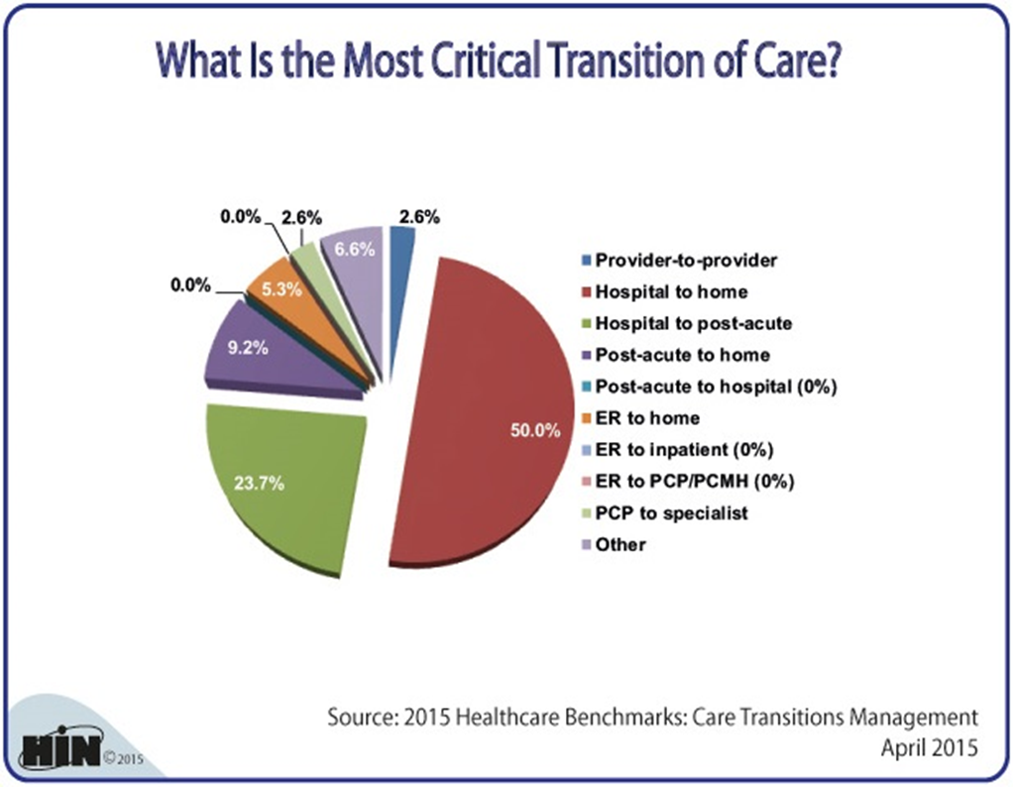
The Most Critical Transition - Hospital to Home

Slide 16
Georgia CAREgivers Act Purpose
Ensure that Georgia hospitals give all patients the option to involve caregivers and prepare them for medical care at home.
Designation
  Give ALL Georgia patients the option to designate and
  record the name of a caregiver upon
  admission into any Georgia hospital
Notification
  Contact the family caregiver prior to
  discharge to home

Slide 17
Georgia CAREgivers Act Purpose
Patient Care-Needs/Caregiver Capabilities Discussion
  Hospital discusses patient’s care needs in discharge plan,
  discusses the caregiver’s capabilities and limitations
Training
  Hospital gives caregiver the opportunity to receive instructions on after-care tasks included in the discharge plan to be performed by the caregiver at home
  Caregiver and patient get opportunity to ask questions

Slide 18
Benefits of the Georgia CAREgivers Act
Improved screening procedures surrounding re-admittance risk
  Over 80 Georgia hospitals are facing penalties for their high readmission rates
  Discharge planning interventions with caregiver integration were associated with a 25% fewer readmissions at 90 days
Has led to the creation of innovative chronic disease management programming
Allows for more impactful care

Slide 19
Georgia CAREgivers Act Supporters
Co-Age
Alzheimer's Association, Georgia Chapter
National Aging in Place Council
LeadingAge Georgia
Georgians for a Healthy Future
The Rosalyn Carter Institute for Caregiving
Georgia Gerontology Society

Slide 20
Board Presentation – Ann Campbell-Kelly, Hire Me GA & WIPA, and Dr. Linda Garret, Walton Options

Slide 21


  Hire Me GA is an awareness campaign focused on creating a more empowered workforce in which persons with disabilities are provided equitable opportunities for employment and advancement.
  Walton Options for Independent Living has partnered with Georgia Rehabilitation Institute to bring the campaign to life.

Slide 22


Since Our Launch in 2021
Social Media accounts on Facebook, LinkedIn, & YouTube
TV ads & Digital Billboards throughout the CSRA area
Set-up at the Augusta Business Daily Expo in October as well as presented Inclusion Works training to participants
Updates to the Hire Me GA website

Slide 23
Looking Ahead in 2022
Continuing to reach out via social media & local marketing
Have started recruiting local business experts to guest write articles
for the News Section
Looking for opportunities to be present in the community for
employment education opportunities for job seekers & employers
Support Disability Employment Advocacy through legislative support
and information awareness about benefits for employers
Focus during NDEAM (October) to reach employers

Slide 24
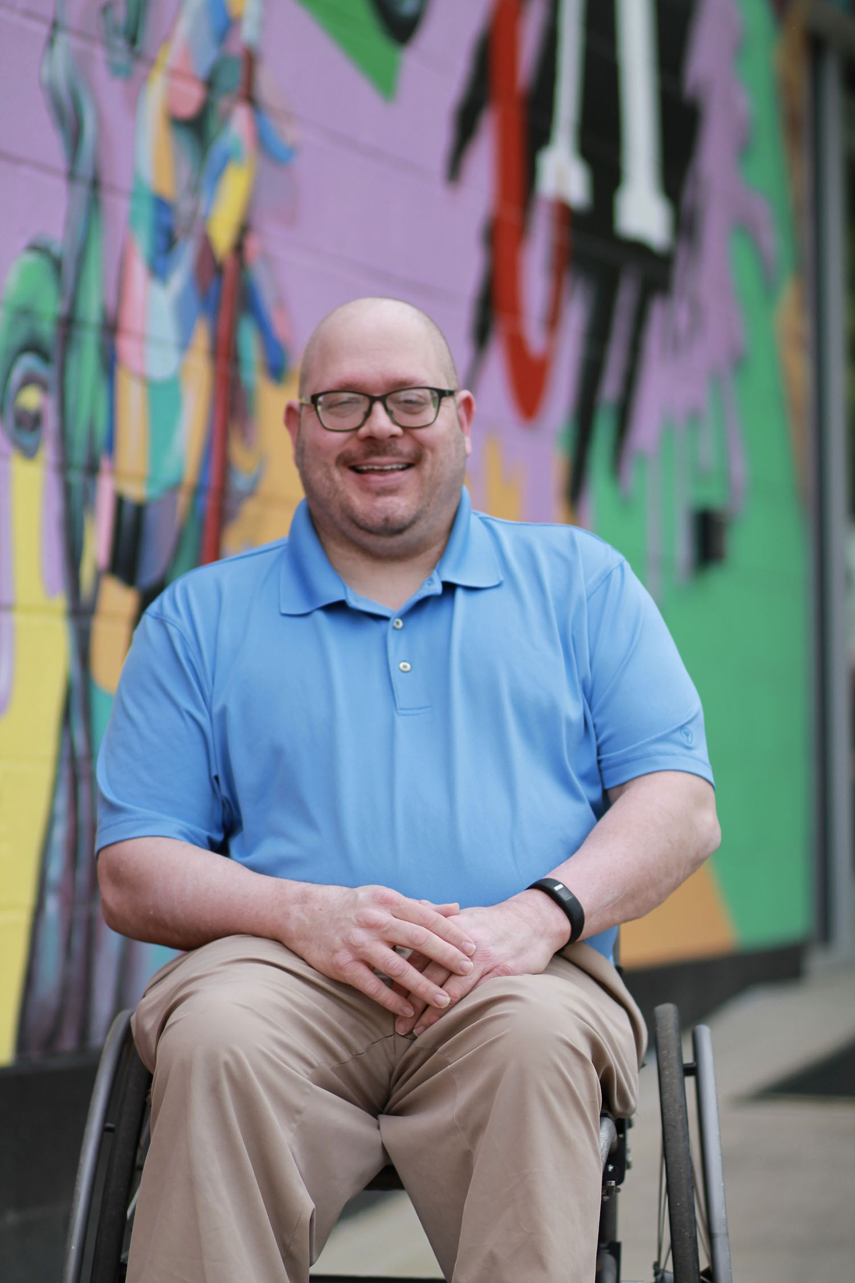
How can you support Hire Me GA?
Continue to share the website, social media posts, and videos
Share job seekers/employees and employers with us to feature – we want to continue to highlight positive experiences and real businesses embracing inclusion and why
Let us know about opportunities to raise awareness/educational opportunities
Work with us to provide guest article content, blogs or vlogs – the more info we can share, the better!
Email any opportunities to acampbell@waltonoptions.org
Notes:
From Employers Perspective Who have embraced accommodating in hiring people with disabilities

Slide 25
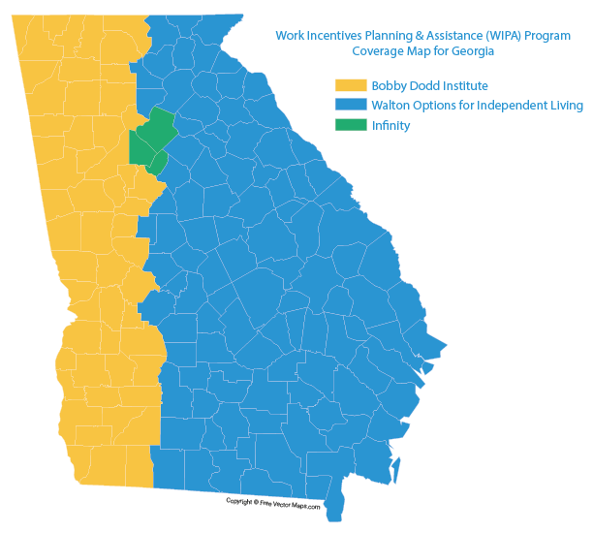
Work Incentives Planning & Assistance (WIPA) Program in GA
WIPA offers a range of services to help consumers understand their options if they choose to pursue work. Community Work Incentive Coordinators (CWICs) provide in-depth counseling about working, earning more money, and how working may affect your benefits.
Service Providers for Georgia:
Walton Options
Infinity
Bobby Dodd Institute

Slide 26
Work Incentives Planning & Assistance (WIPA) Program in GA
For Social Security Disability Insurance (SSDI) Recipients
Trial Work Period
Extended Period of Eligibility
Expedited Reinstatement
Continuation of Medicare
Impairment-Related Work Expenses
Subsidies and Special Conditions
Section 301
For Supplemental Security Income (SSI) Recipients
Continuation Of SSI
Continuation Of Medicaid Eligibility
Plan for Achieving Self-Support
Impairment-Related Work Expenses
Blind Work Expenses
Student Earned Income Exclusion
Sheltered Workshop Payments
Section 301

Slide 27

Ticket to Work & Self-Sufficiency Program
The TTW Program is for SSI or SSDI beneficiaries who want to work and participate in planning their employment. Participation in the TTW program increases your available choices when obtaining employment services, vocational rehabilitation services, and other support services you may need to get or keep a job. It is a free and voluntary service. When you participate in the TTW program, you are using your ticket. You might not be subject to a continuing disability review while you are using your Ticket.
Notes:
Walton Options is an official Employment Network of the Social Security Administration that provides Ticket to Work Program services. Ticket to Work is a free and voluntary program that is available to persons aged 18 to 64 who have a disability and receive Social Security Disability Insurance (SSDI) or Supplemental Security Income (SSI) benefits.
The goals of the Ticket to Work Program are to:
Offer beneficiaries with disabilities expanded choices when seeking service and supports to enter, re-enter, and/or maintain employment;
Increase the financial independence and self-sufficiency of beneficiaries with disabilities; and
Reduce and, whenever possible, eliminate reliance on disability benefits

Slide 28

Questions & Answers
Thank you for joining us today!
Email us at hiremega@waltonoptions.org with any follow up questions.

Slide 29
Executive Director’s Report – Shelly Simmons

Slide 30
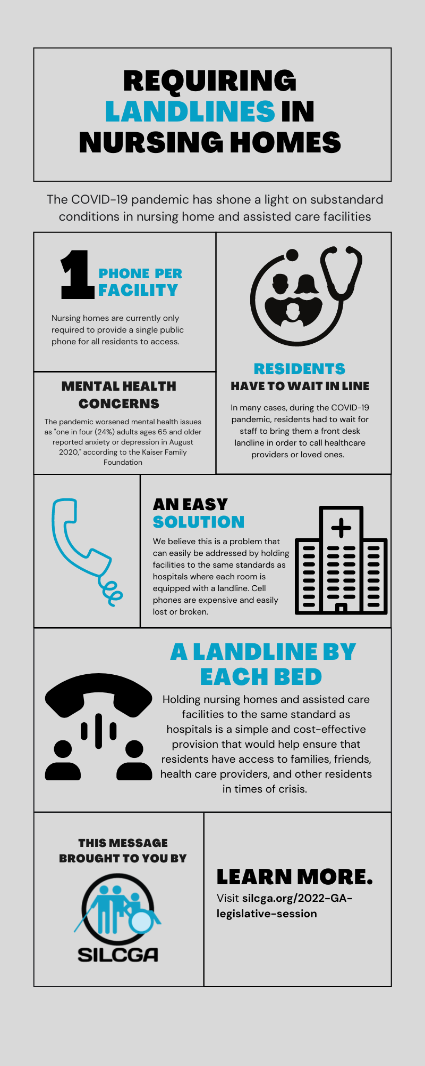

Slide 31
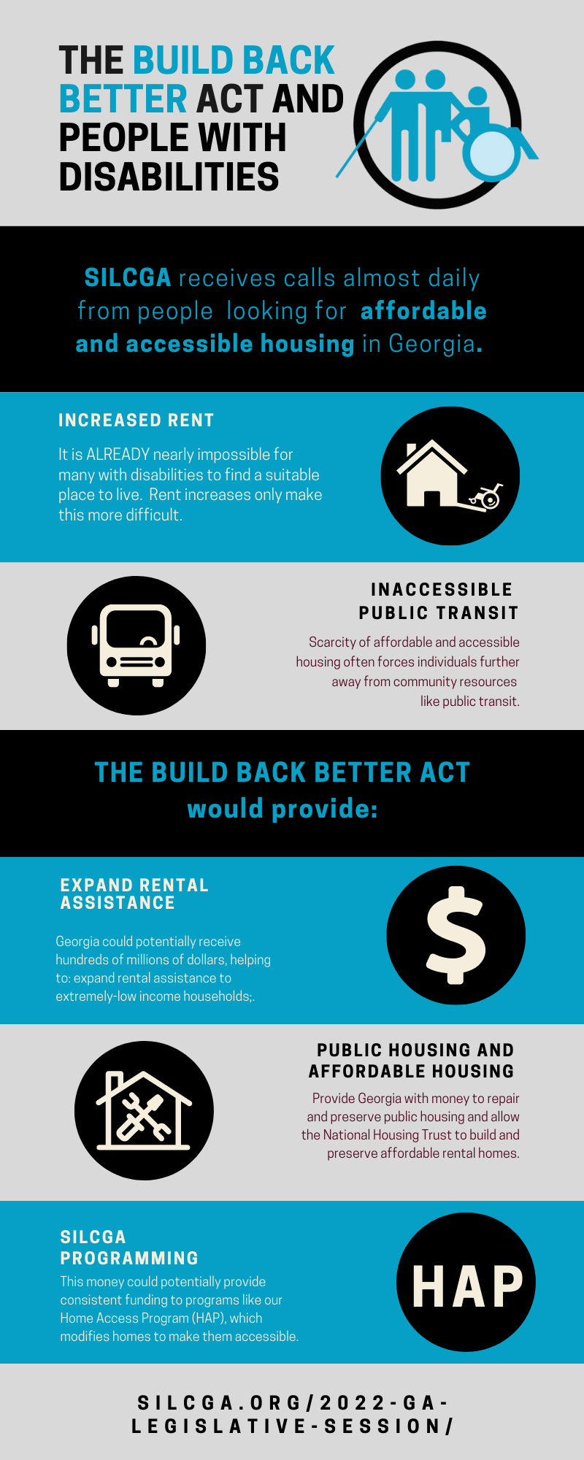

Slide 32
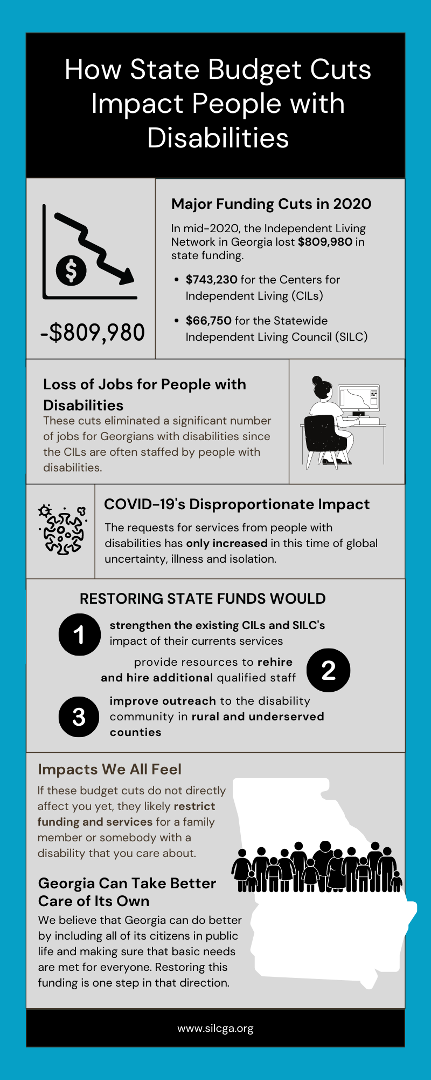

Slide 33
Brag & Steal Reports

Slide 34
Next Meeting Schedule & Adjournment – Shelia Kitchens & Becky Ramage-Tuttle

Slide 35
THANK YOU for your continued hard work!

