Slide 1
JANUARY 2025 - BOARD MEETING

Slide 2
CALL TO ORDER

Slide 3
ROLL CALL

Slide 4
TODAY’S AGENDA
Call to Order – Shelia Kitchens
Roll Call – Shelly Simmons
Review & Adoption of Agenda – Shelia Kitchens
Review & Adoption of Minutes - Shelia Kitchens
Board Presentation – Kim McKnight, GA Department of Community Health
Budget Review – Becky Ramage-Tuttle
Executive Director’s Report – Shelly Simmons
Brag & Steal Reports
Next Meeting & Adjournment – Shelia Kitchens

Slide 5
REVIEW AND APPROVE
Current Agenda
Previous Minutes

Slide 6
Board Presentation
Kim McKnight
GA Department of Community Health

Slide 7
Budget Review

Slide 8
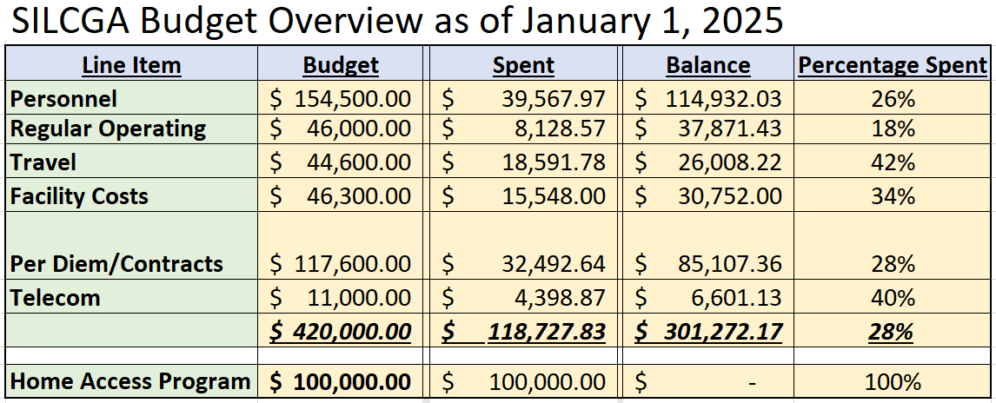

Slide 9
Executive Director’s Report

Slide 10
Enable Work

Slide 11
HAP - Home Access Program

Slide 12
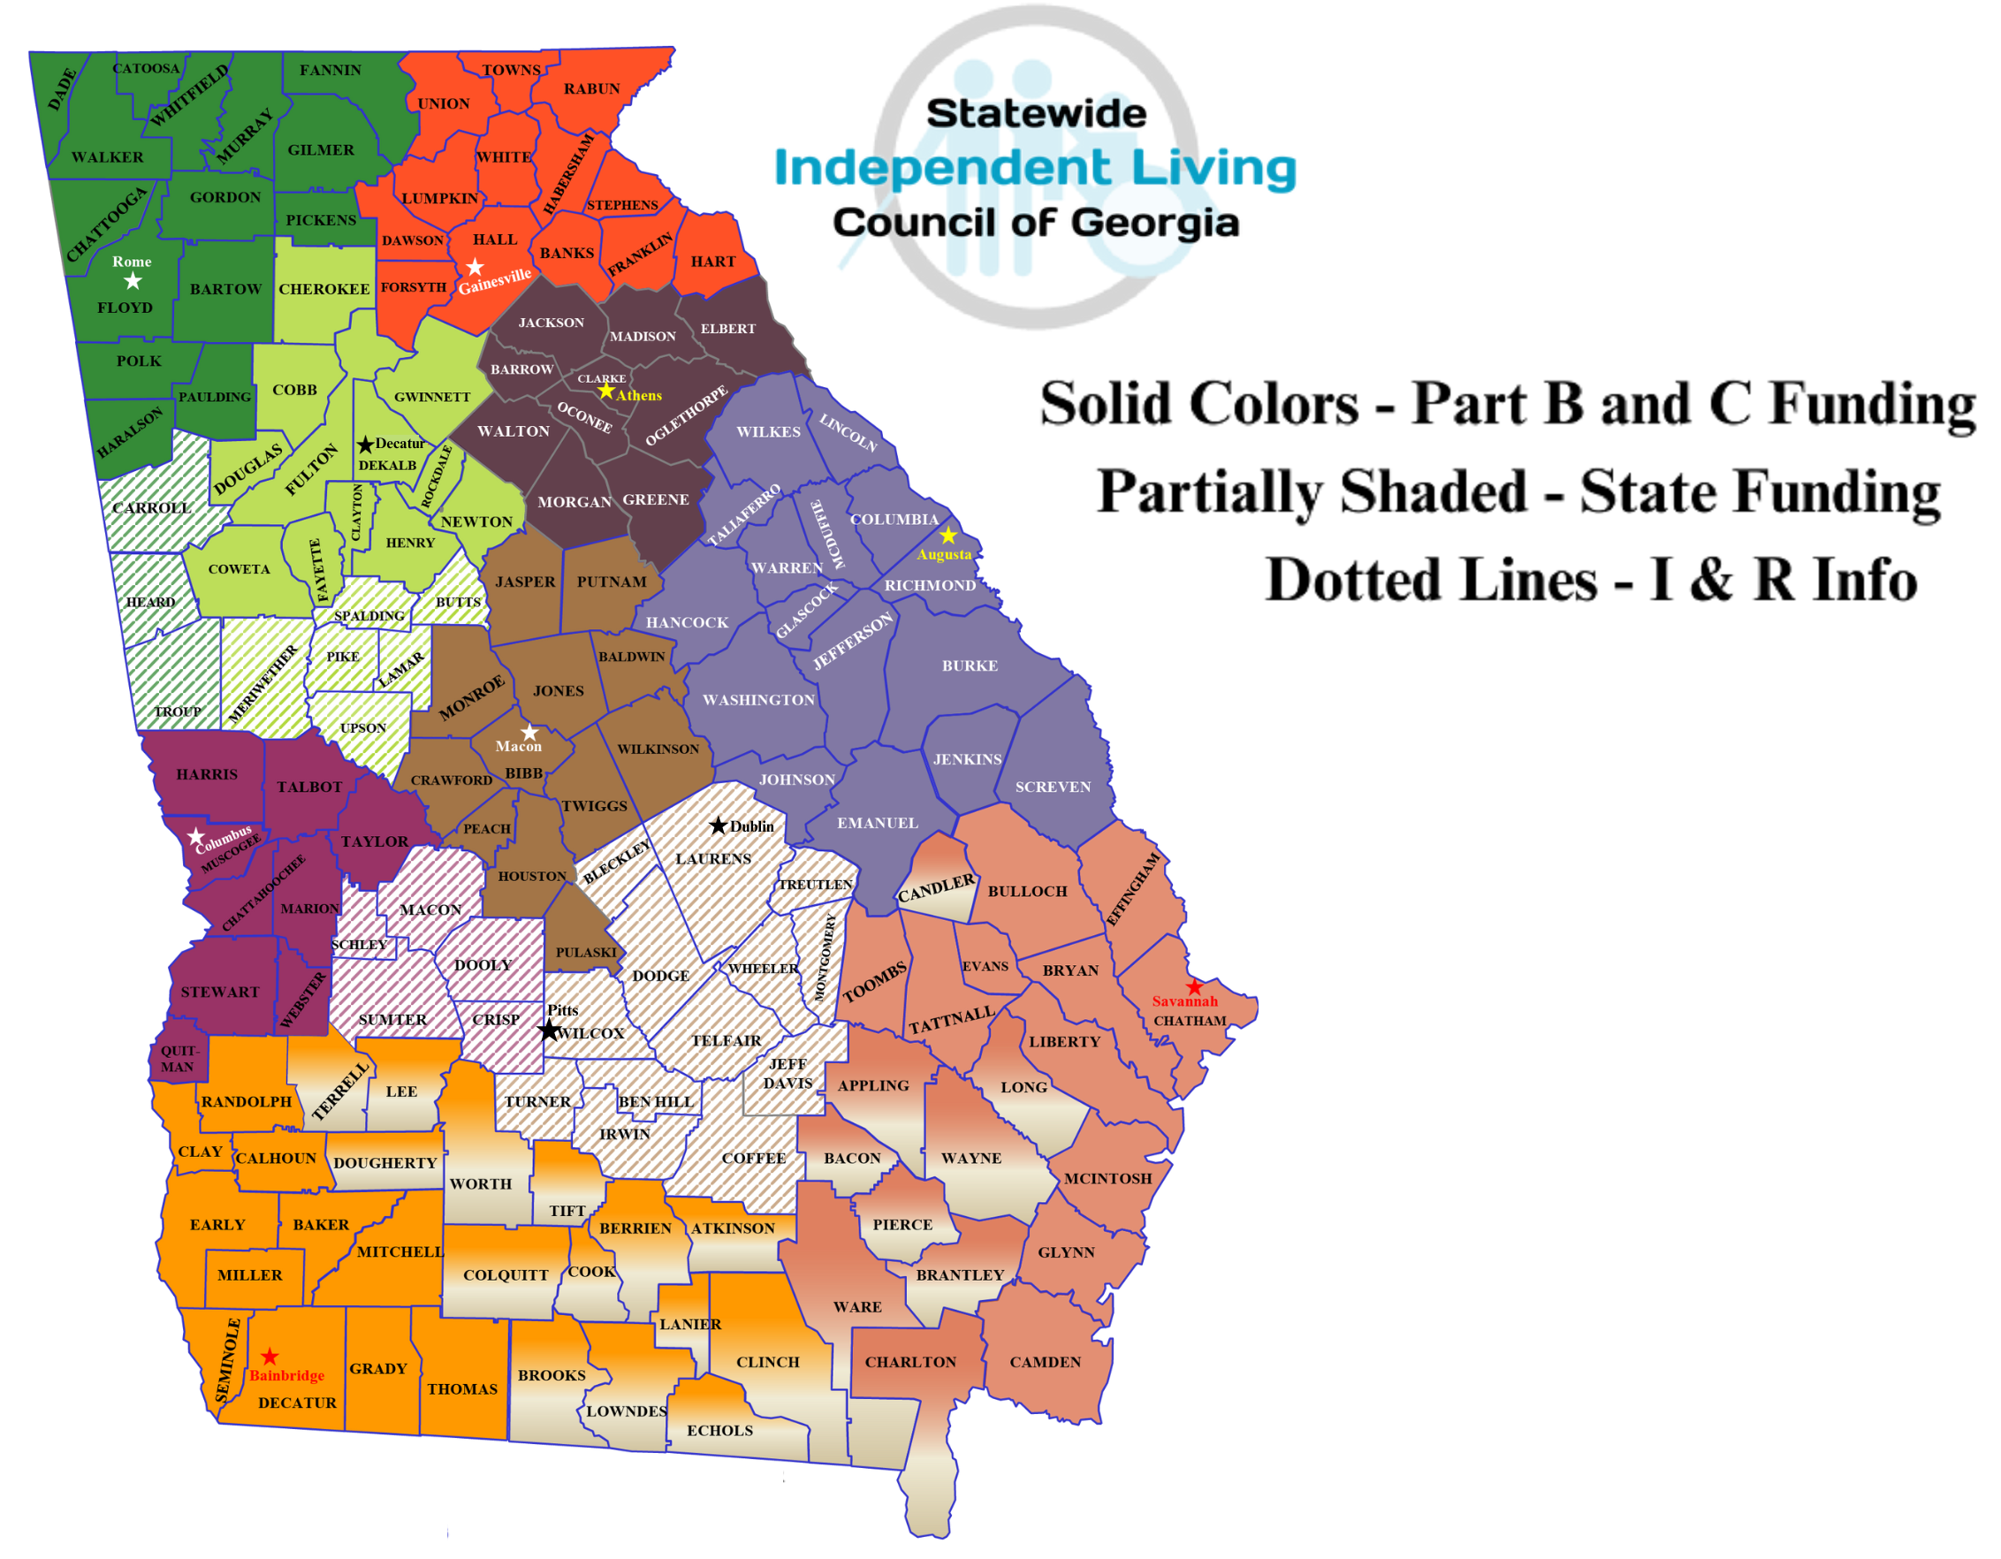

Slide 13
BRAG & STEAL

Slide 14
Next Meeting & Adjournment

Slide 15
THANK YOU for your continued hard work!

