Slide 1
APRIL 2025
BOARD MEETING

Slide 2
CALL TO ORDER

Slide 3
ROLL CALL

Slide 4
TODAY’S AGENDA
Call to Order
Roll Call
Review and Approval of Agenda
Review and Approval of Minutes
Budget
Board Presentation – ITS4US Project
Executive Director’s Report
Brag & Steal Reports
Next Meeting & Adjournment

Slide 5
REVIEW AND APPROVE
Current Agenda
Previous Minutes

Slide 6
Budget Review

Slide 7
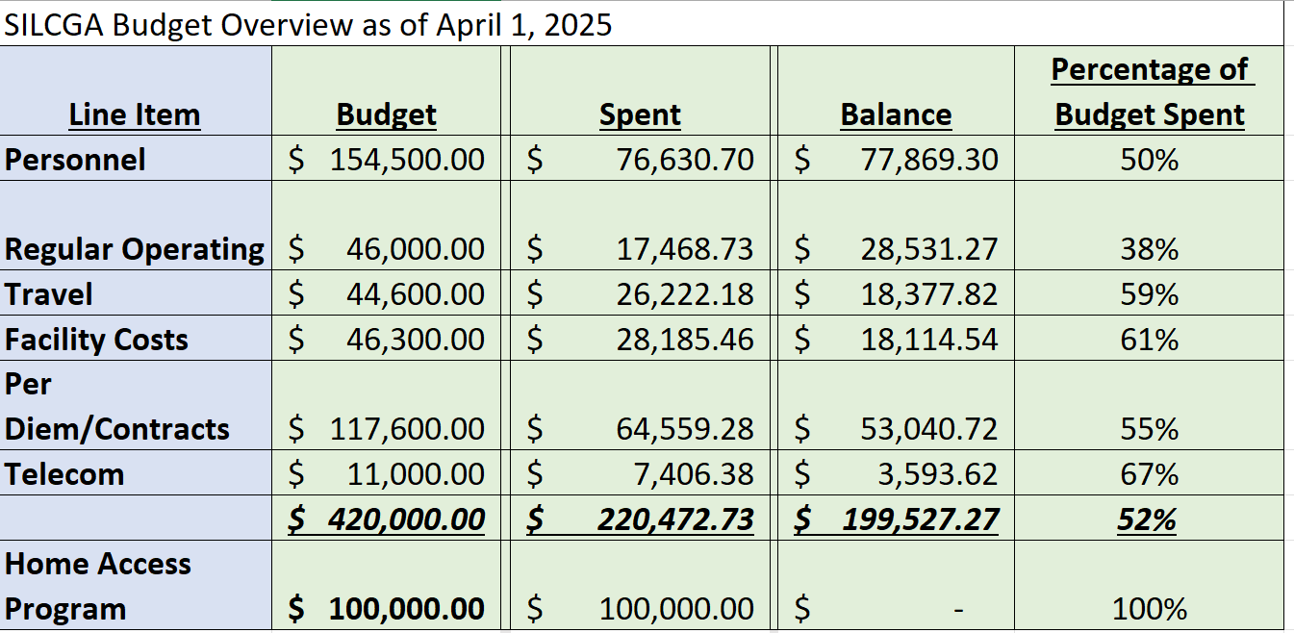

Slide 8
Board Presentation: ITS4US Project

Slide 9
Executive Director’s Report

Slide 10
BRAG & STEAL

Slide 11
Next Meeting & Adjournment

Slide 12
THANK YOU for your continued hard work!

